Slide 1


TourismAPP
TravelGuide.in
“To travel is to live”
Wireframe – First Draft

Slide 2
Design for Home page
PowerPoint Designer suggests professional designs for your presentation, based on the content in your slides.
Designer is a subscription-only feature. If you have an Office 365 subscription, the next slide shows you how it works in a new presentation.

Slide 3
Booking page
How it works:
1
User Can login from the web main page Contact Page> Fill> Submit.
2
Once booking done registered user will get the details via us /her email with the location picture.
3
Travel guide will contact and take you on the part of location and other details.
4
They can modify and change the location based on there requirement.

Slide 4
Key considerations:
Try it yourself with these two simple “planets”:
TravelGuide.in
1
Look and feel Brand identify TravelGuide.in Keeping as this slide: Right-click the slide thumbnail and select.
TravelGuide.in
2
Navigation bar: Home page, About Us, Location, Contact Us
3
Footer: Brand , Quick links, social media link.

Slide 5
Web tool user flow:
Help user to navigate from the required page and to get the details. How it works:
1
Select Navigate from above the router nav options, or by using scroll do down the main page and see the options.
2
We can use the Search option to get the available Travel details and the images of the place.
3
Help line number to reach out to the Head Office

Slide 6

Agenda
Project Requirement and marketing requirements with the customers needs should knowing.
SELECT ME
1
Business needs and the design.
2
Content animation in the Slid bar, and then choose navigation.
3
Design, Data flow, Content , Images of the web portal.

Slide 7
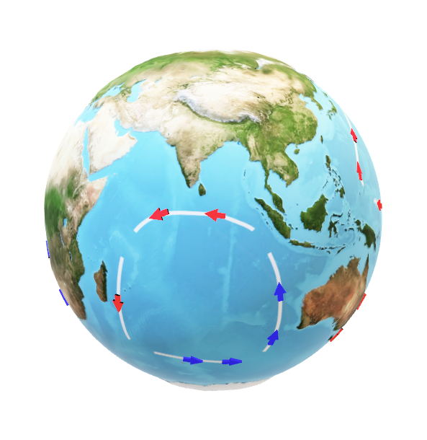
Services :
1
Worldwide travel location place guide and services are provided.
2
We provide login details to verify the location services and there place importance
3
The list of document will be shared once the register by the user and we provide package details via email.

Slide 8
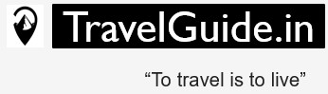
Thank you

